Slide 1
EES203: Geochemistry
Instructor: Anoop Ambili
Email id: anoop@iisermohali.ac.in

Slide 2
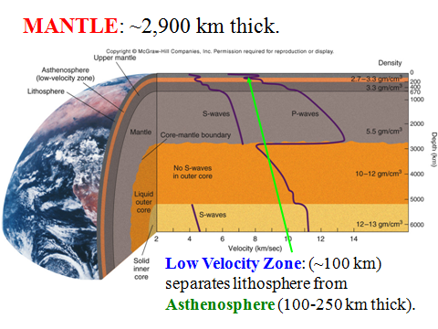
Mantle: 83% of the volume and 68.3% of the mass of the Earth

Slide 3
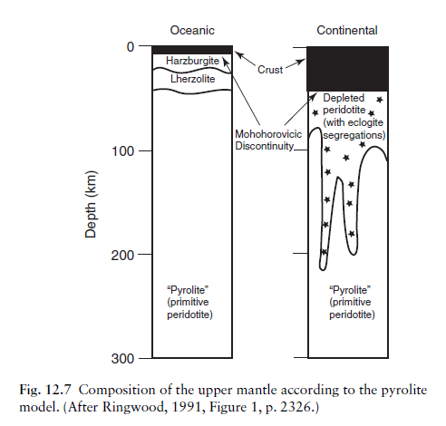

Slide 4
Lherzolite: A type of peridotite with Olivine > Opx + Cpx
Olivine
Dunite
90
Peridotites
Wehrlite
Harzburgite
Lherzolite
40
Orthopyroxenite
Olivine Websterite
Pyroxenites
10
10
Websterite
Orthopyroxene
Clinopyroxenite
Clinopyroxene
Figure 2-2 C After IUGS

Slide 5
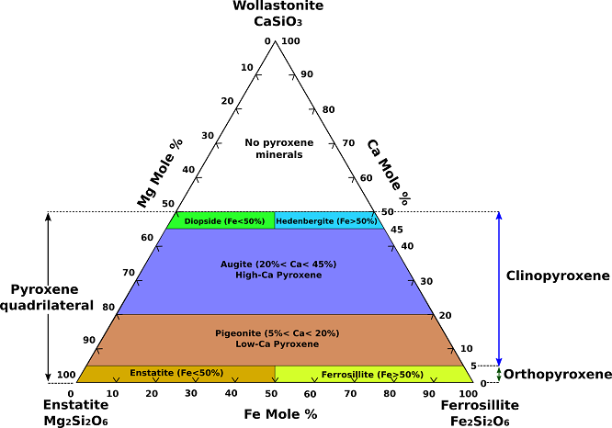

Slide 6
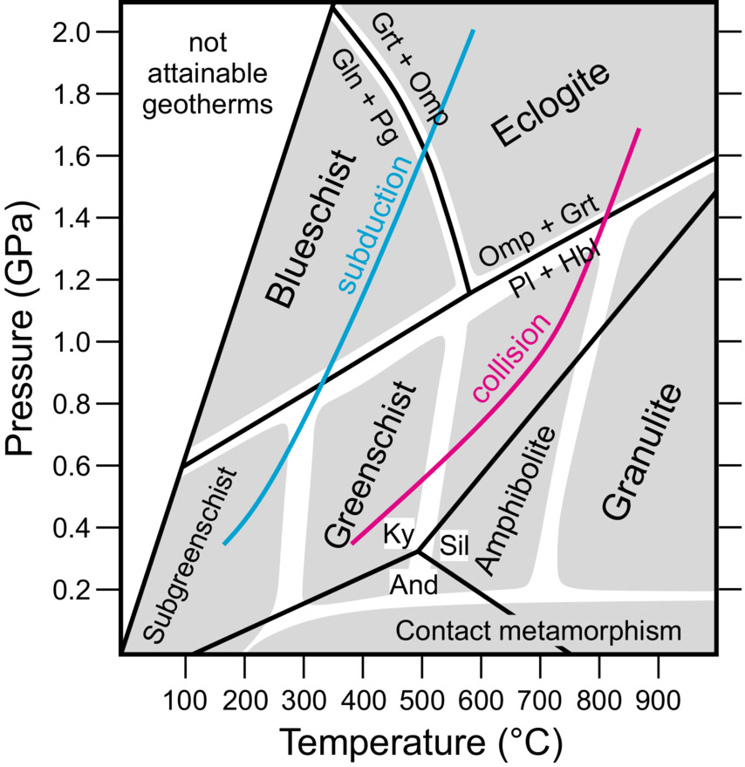
Eclogites
Glaucophane: Na2​Mg3​Al2​Si8​O22​(OH)
Geology Today, Volume: 40, Issue: 1, Pages: 33-40, First published: 08 February 2024, DOI: (10.1111/gto.12462)
Notes:
Metamorphic facies diagram based on assemblages of metabasaltic rocks with representative geotherms for subduction and collision. The geotherms are curves that show the increase in temperature with depth within the Earth, and their position depends on the geotectonic setting. Key reactions that defined the boundaries of the eclogite facies are indicated (Grt = garnet, Omp = omphacite, Gln = glaucophane, Pg = paragonite, Pl = plagioclase, Hbl = hornblende). Phase transitions of the aluminosilicates (Al2SiO5) are given for comparison (Ky = kyanite, Sil = sillimanite, And = andalusite) (modified from Bucher and Grapes 2011).
IF THIS IMAGE HAS BEEN PROVIDED BY OR IS OWNED BY A THIRD PARTY, AS INDICATED IN THE CAPTION LINE, THEN FURTHER PERMISSION MAY BE NEEDED BEFORE ANY FURTHER USE. PLEASE CONTACT WILEY'S PERMISSIONS DEPARTMENT ON PERMISSIONS@WILEY.COM OR USE THE RIGHTSLINK SERVICE BY CLICKING ON THE 'REQUEST PERMISSIONS' LINK ACCOMPANYING THIS ARTICLE. WILEY OR AUTHOR OWNED IMAGES MAY BE USED FOR NON-COMMERCIAL PURPOSES, SUBJECT TO PROPER CITATION OF THE ARTICLE, AUTHOR, AND PUBLISHER.

Slide 7
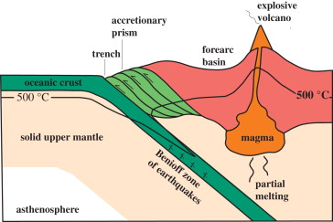

Slide 8
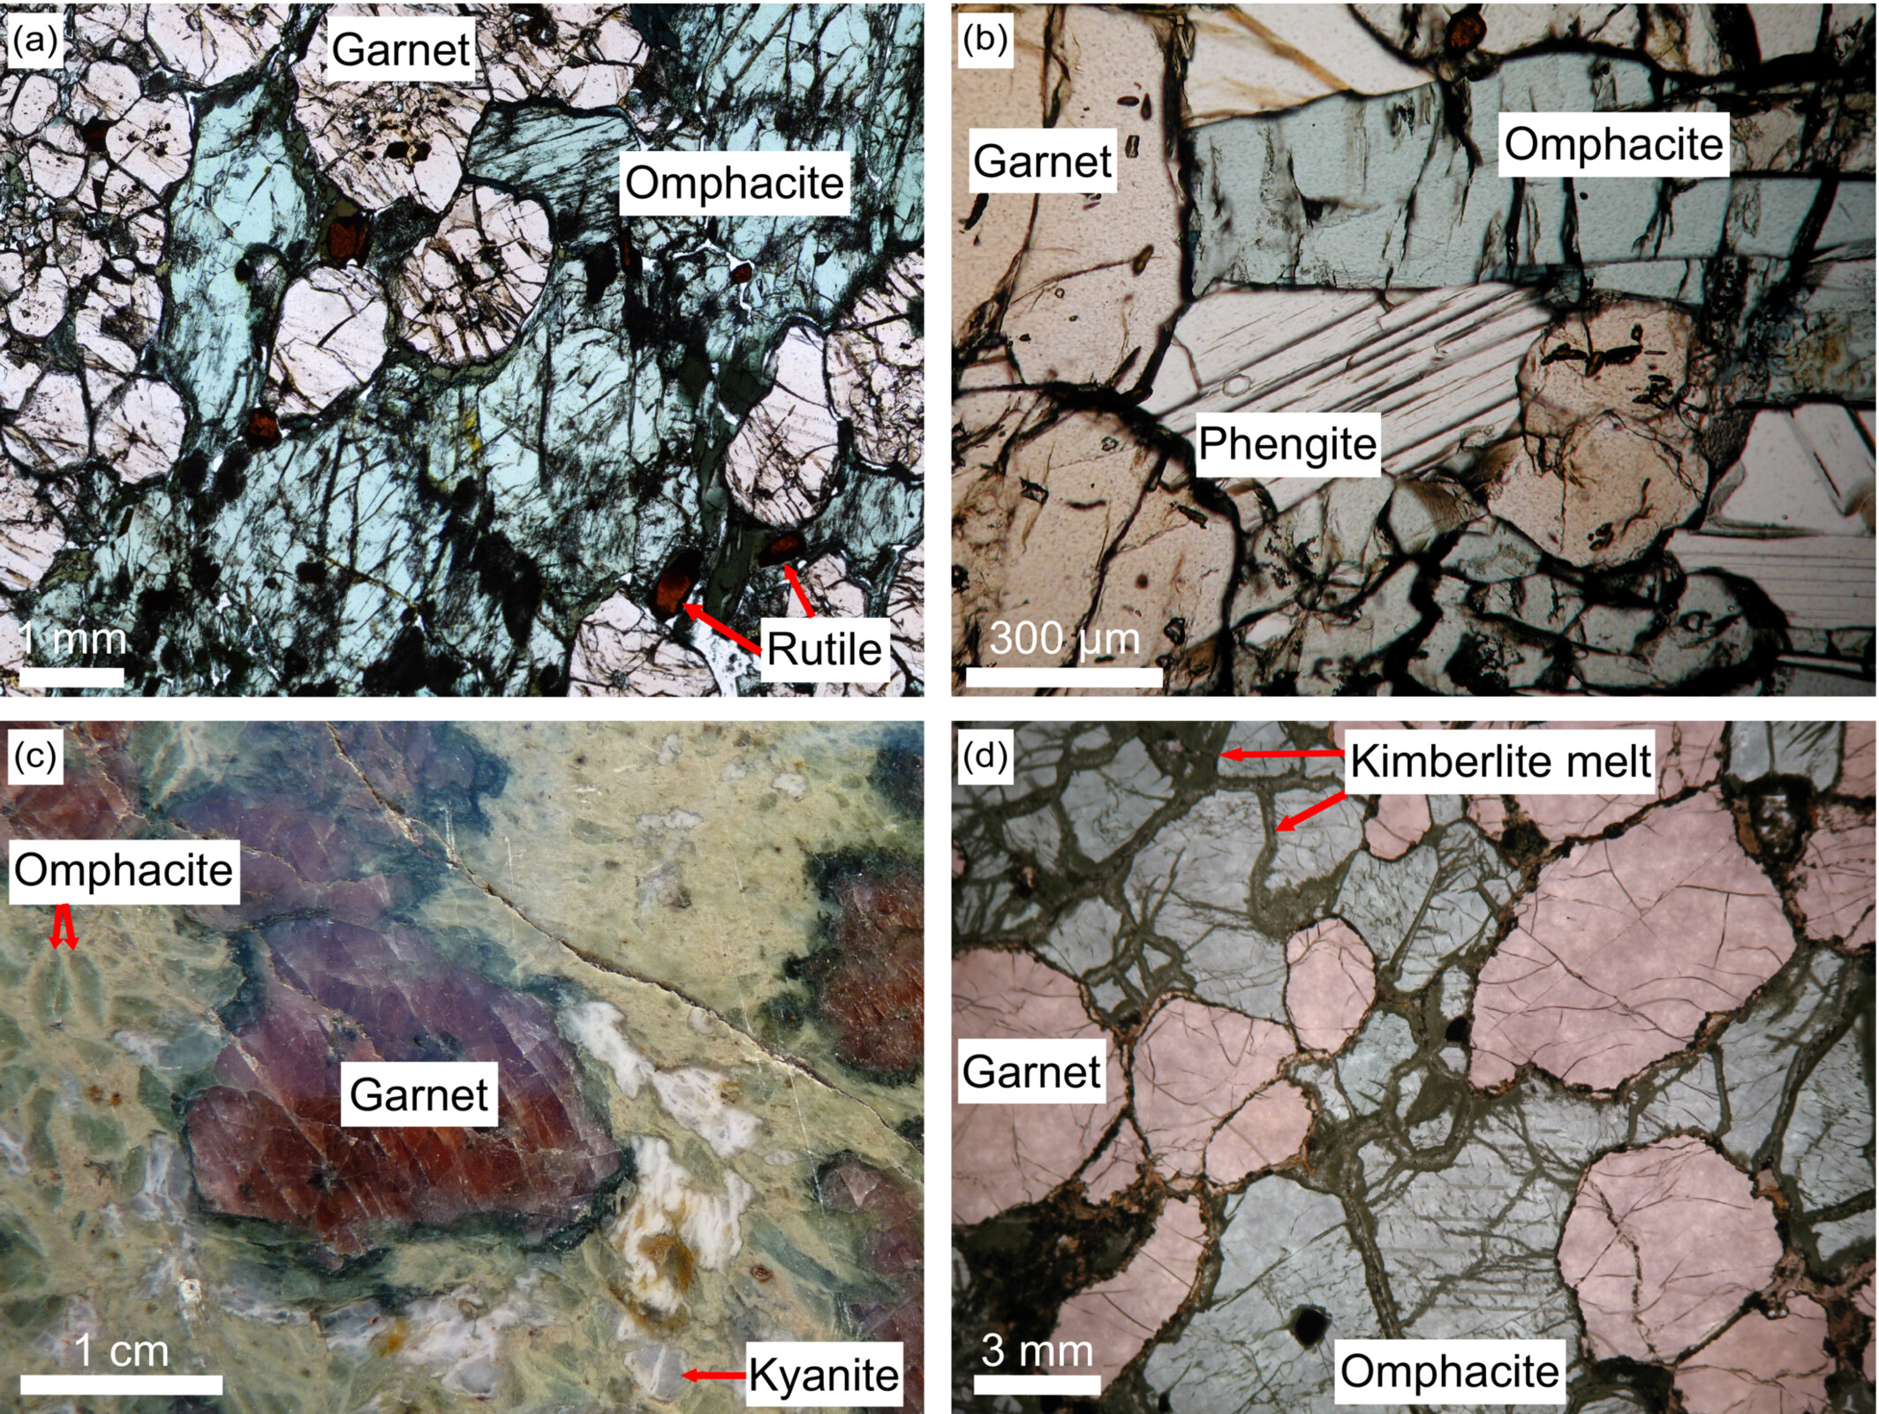
Eclogites
Geology Today, Volume: 40, Issue: 1, Pages: 33-40, First published: 08 February 2024, DOI: (10.1111/gto.12462)
Notes:
Eclogites in polished sections and thin sections. (a) Eclogite from Glenelg (Scotland). Pink garnet and light green omphacite are the major minerals, brown rutile occurs as accessory mineral, and dark green amphibole replaces omphacite. (b) Eclogite from the Raspas Complex (Ecuador) with garnet, omphacite and phengite. The protolith is a mid‐ocean ridge basalt. (c) La Compointrie eclogite (La Piltière, Saint‐Philbert‐de‐Grand‐Lieu, France), a Mg‐rich eclogite with red garnet, bluish kyanite and emerald‐green omphacite surrounded by a matte greenish matrix. Retrogression is indicated by pseudomorphs after kyanite (white spots) and amphibole‐rich coronas around garnet. The protolith is a cumulate of a tholeiitic differentiation sequence (olivine leucogabbro). (d) Eclogite xenolith from the Koidu kimberlite cluster (Sierra Leone). During ascent of the xenolith in the kimberlite melt, decompression causes the minerals to crack, which facilitates melt infiltration and alteration that can be seen as the dark green material (Photo courtesy of Sonja Aulbach).
IF THIS IMAGE HAS BEEN PROVIDED BY OR IS OWNED BY A THIRD PARTY, AS INDICATED IN THE CAPTION LINE, THEN FURTHER PERMISSION MAY BE NEEDED BEFORE ANY FURTHER USE. PLEASE CONTACT WILEY'S PERMISSIONS DEPARTMENT ON PERMISSIONS@WILEY.COM OR USE THE RIGHTSLINK SERVICE BY CLICKING ON THE 'REQUEST PERMISSIONS' LINK ACCOMPANYING THIS ARTICLE. WILEY OR AUTHOR OWNED IMAGES MAY BE USED FOR NON-COMMERCIAL PURPOSES, SUBJECT TO PROPER CITATION OF THE ARTICLE, AUTHOR, AND PUBLISHER.

Slide 9
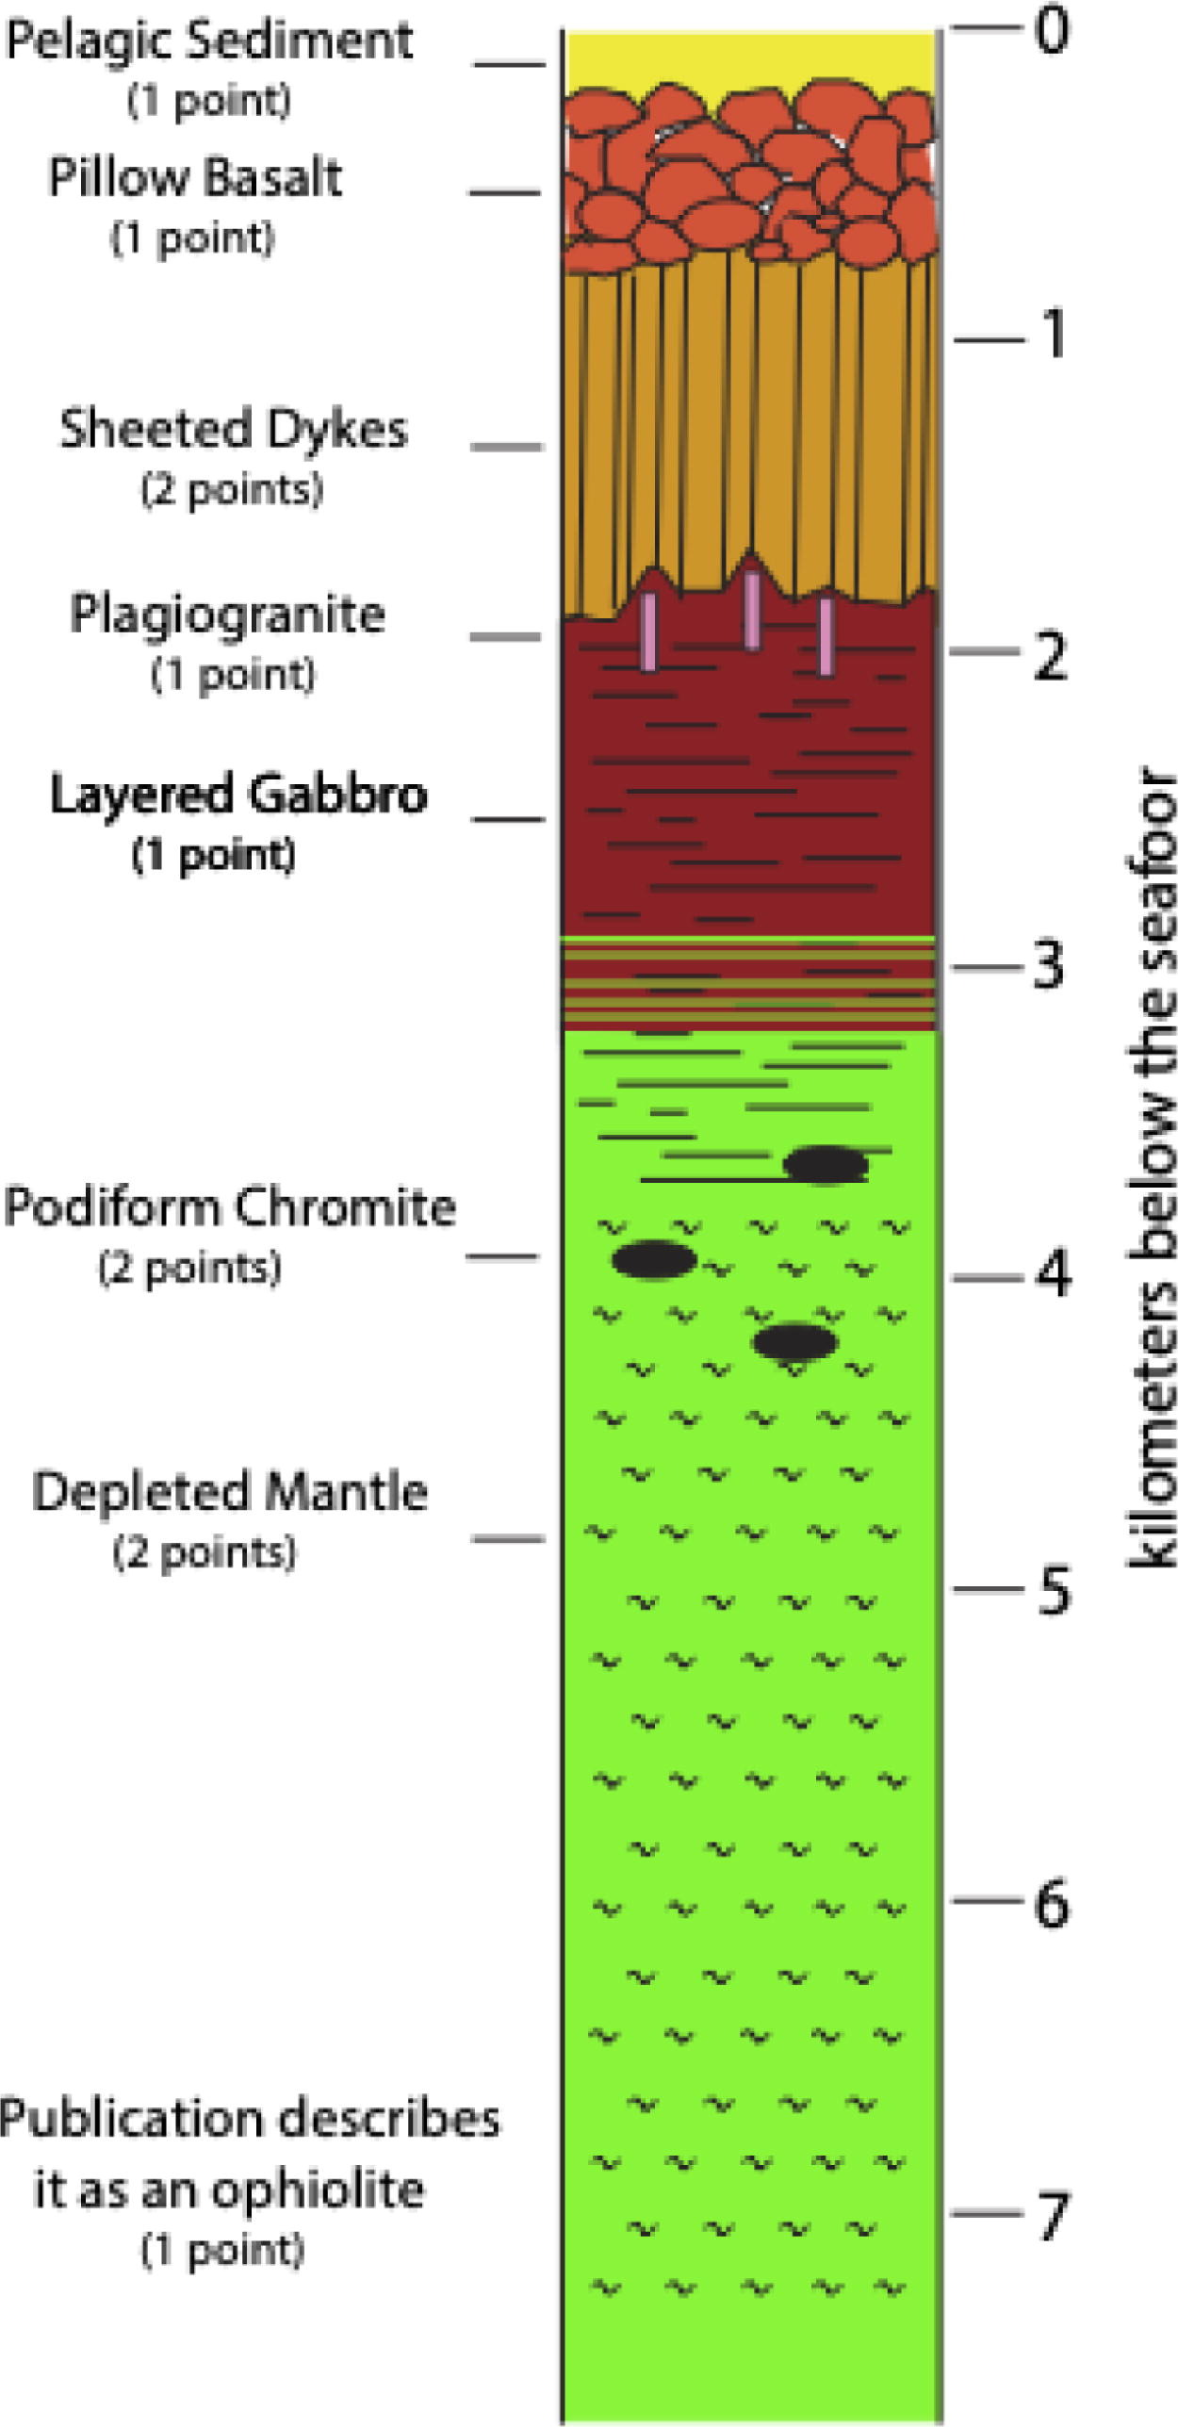
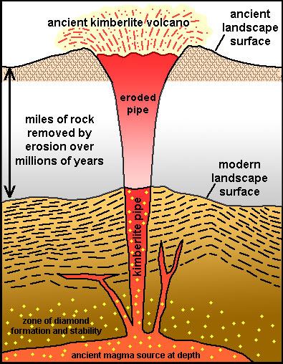
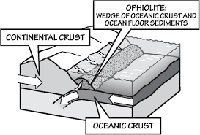

Slide 10
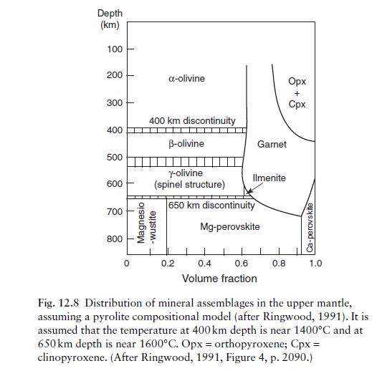
Spinel: magnesium aluminate (MgAl₂O₄),

Slide 11
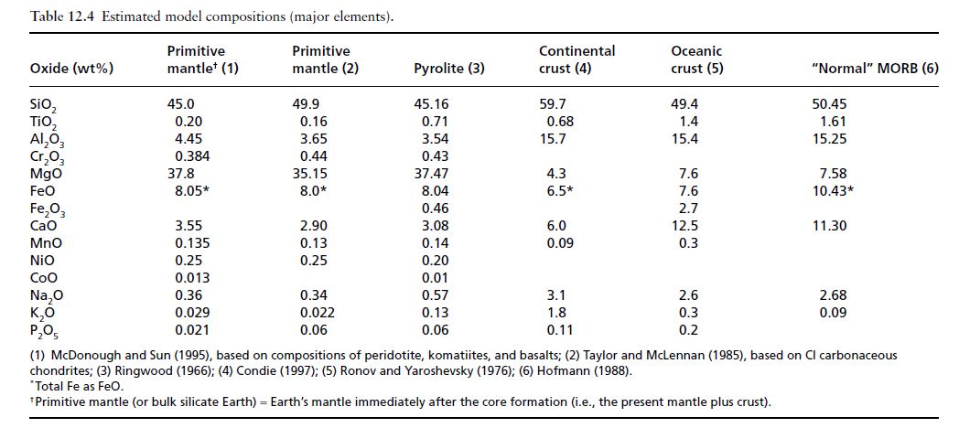

Slide 12
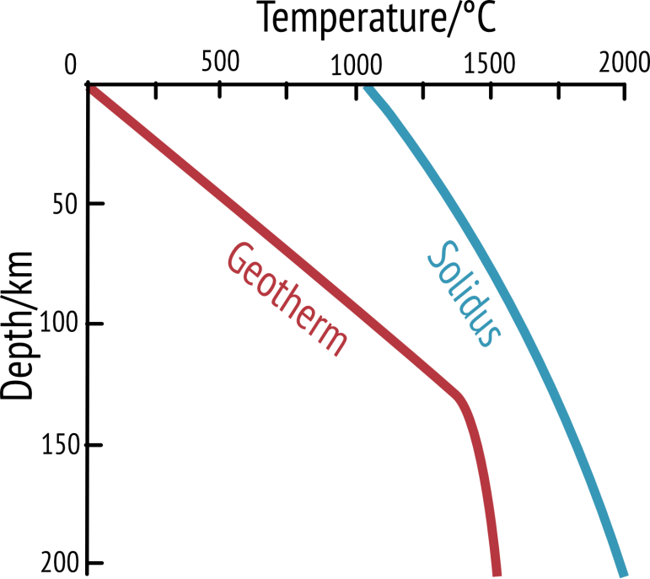
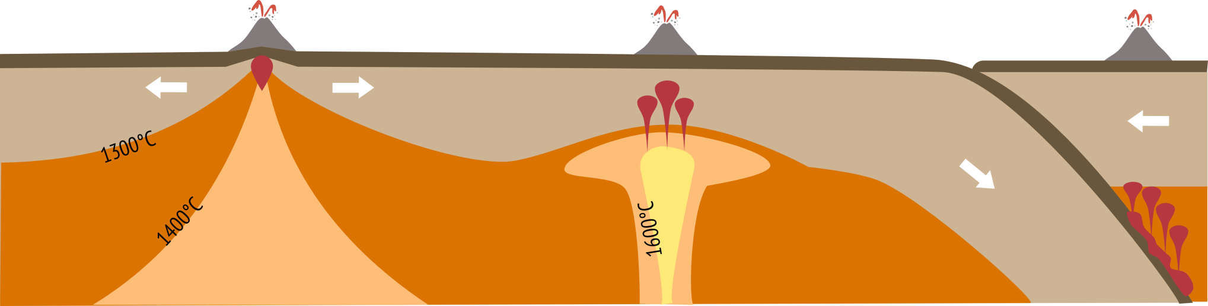
Magma generation
Average section of crust and mantle (i.e. away from plate boundaries)
No magma generated
Notes:
The red line on the graph is the geothermal gradient which shows the rate of increasing temperature with respect to increase with depth into the Earth’s interior. On average (i.e. away from plate boundaries) temperature increases at a rate of 25-30°C per km in the lithosphere. The kink in the geothermal gradient indicates the lithosphere-asthenosphere boundary which occurs at 1300°C.
For rocks to melt the geothermal gradient (or geotherm) must cross the solidus (blue line). The solidus marks the transition from solid mantle rock to rock that can melt and form pockets of magma. Because of pressure increases the solidus increases in temperature the further down you go. In an average section of crust and mantle the geotherm does not cross the solidus and therefore no liquid magma can be produced (the solidus is for the rock peridotite which makes up the average composition of the mantle).
There are three situations where we can get the geotherm to cross the solidus and therefore we can get melting and so we can get magma for our volcanoes.

Slide 13
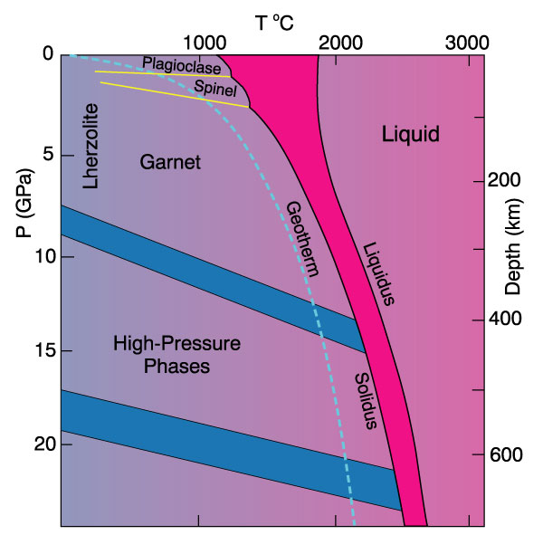

Slide 14

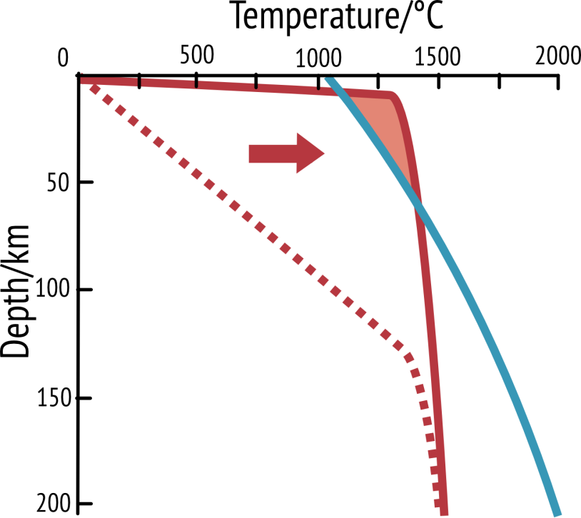
1. Mid ocean ridge
Magma generated
Notes:
This graph shows what happens at a constructive/divergent boundary – a point where two plates are moving away from each other (for example in the Mid Atlantic ridge). Because the lithosphere is thinned here, the asthenosphere (which is hotter) rises and therefore the geotherm is much shallower and crosses the solidus near the top of the graph. Therefore in this zone magma can be generated and we can get volcanoes and new basaltic ocean crust.

Slide 15
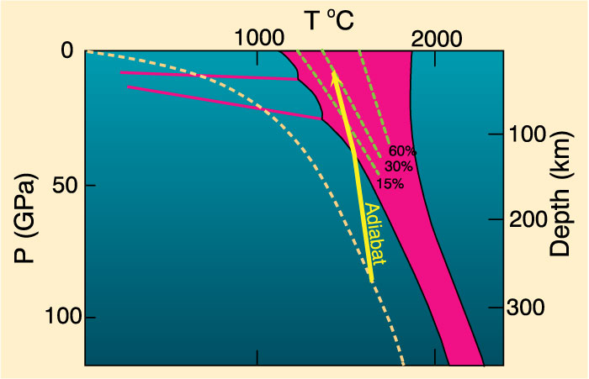
Decompression melting could melt at least 30%
Figure 10-4. Melting by pressure reduction. Melting begins when the adiabat crosses the solidus and traverses the shaded melting interval. Dashed lines represent approximate % melting.
Notes:
Adiabatic rise of mantle with no conductive heat loss
Steeper than solidus
Intersects solidus
Δ slope = heat of fusion as mantle melts
Decompression melting could melt at least 30%

Slide 16

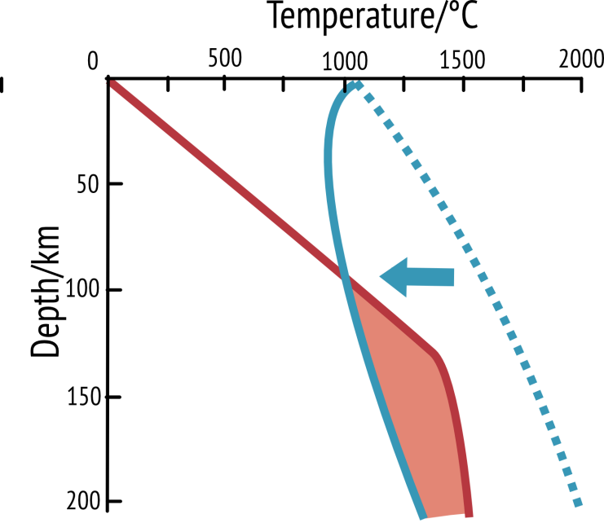
3. Subduction zone
Magma generated
Notes:
This graph shows what happens when water gets into the mantle – this is what happens at subduction zones (destructive/convergent boundaries) where one tectonic plate is thrust beneath another. Hydrated minerals in the crust heat up and release water into the mantle lowers the mantles melting point and therefore the shape of the solidus changes – hydrated mantle rocks melt at a lower temperature and whilst the geotherm has stayed the same, it now crosses over the solidus and can generate magma.

Slide 17
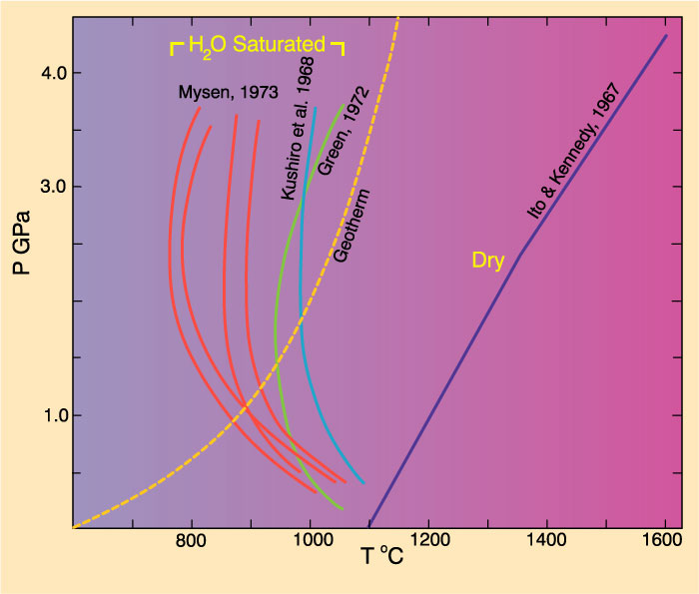
Add volatiles (especially H₂O)
Figure 10-4. Dry peridotite solidus compared to several experiments on H2O-saturated peridotites.

Slide 18
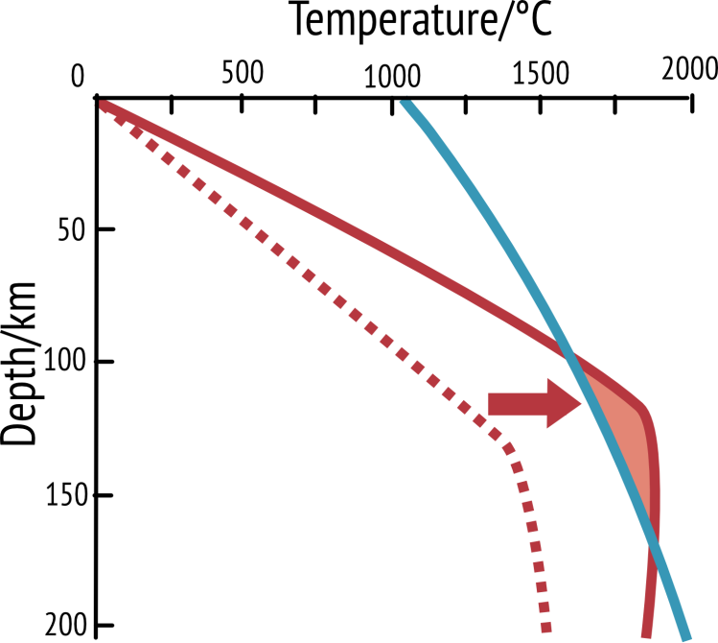
Magma generated
2. Hotspot
Notes:
This graph shows what happens when we increase the temperature of the mantle. This happens when there is a hotspot in the mantle for example under the Hawaiian Islands. Because the mantle temperature is hotter than usual, the geotherm shifts to the right and crosses the mantle solidus. Therefore we can generate molten magma.

Slide 19
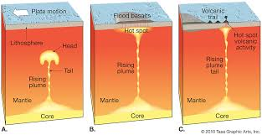
Hotspots

Slide 20
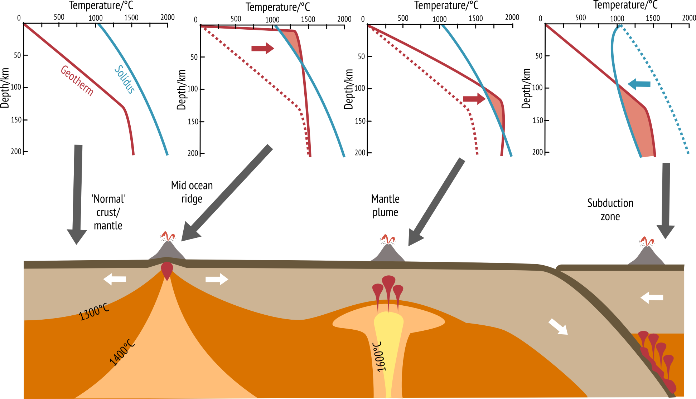
Magma generation from the mantle
a)
b)
c)
d)

Slide 21
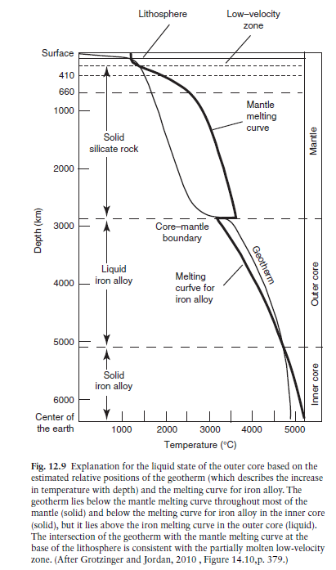
The Earth’s core comprises about 16% of the Earth’s volume and 31% of the Earth’s mass.
Composition for the core (in wt%): Fe – 85.55, O – 5.18, Ni – 4.88, S – 2.69, Cr – 0.45, Mn – 0.41, P – 0.35, Co – 0.22, Cl – 0.07, and possibly K – 0.02

Slide 22
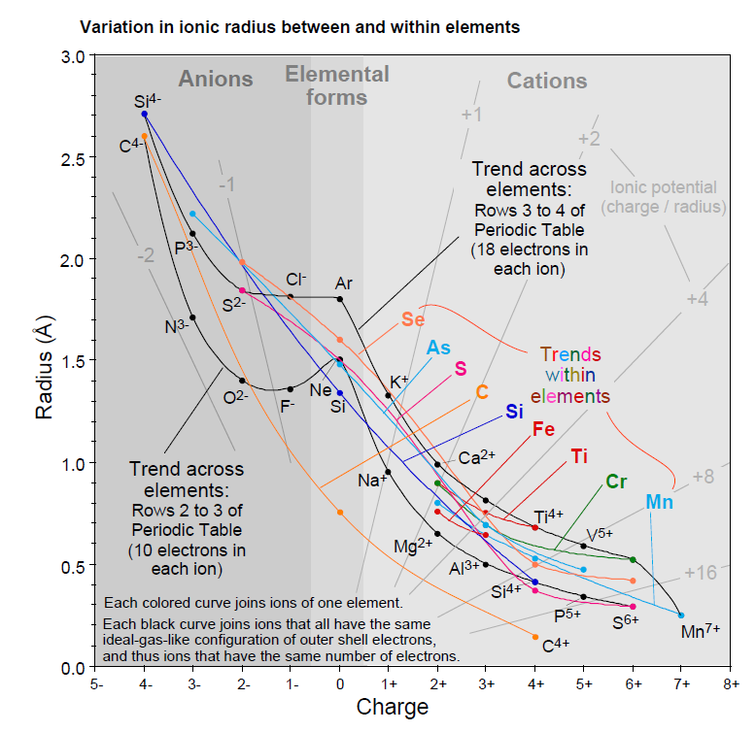
Magmatic differentiation and melt generation

